Slide 1
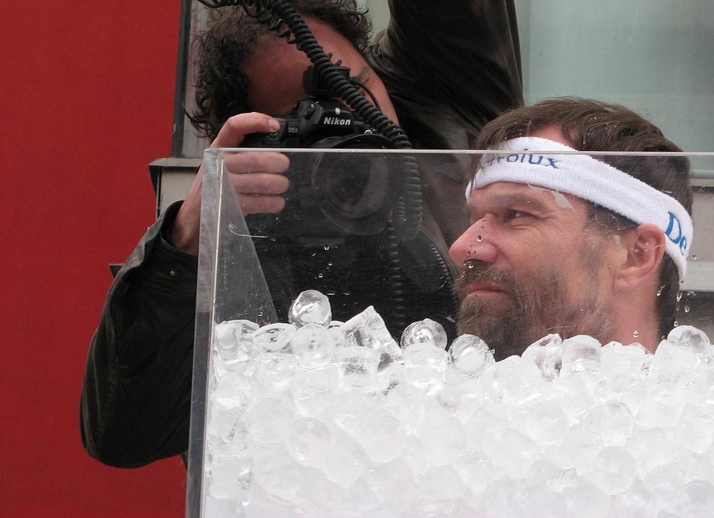
Homeostasis
https://en.wikipedia.org/wiki/Wim_Hof#/media/File:Wim_Hof.jpg
Designed by: Justin Shaffer
justin@recombinanteducation.com

Slide 2
Learning Objectives
Define and explain terms relating to homeostasis and give physiological examples of each
Compare and contrast the pathways and steps in negative and positive feedback loops and give physiological examples of each

Slide 3
PodCase: Homeostasis
Credit: Spotify

Slide 4
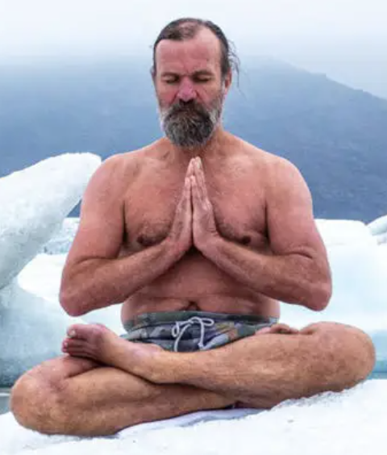
Wim Hof
Dutch extreme athlete and motivational speaker
Has done many stunts in the cold including climbing mountains in shorts and barefoot, body contact with ice, and barefoot half marathons in snow and ice
He also has mastered breathing exercises
https://www.wimhofmethod.com/
https://saludyvida.tips/conoce-todo-sobre-el-wim-hof-method-en-wellshop/
https://en.wikipedia.org/wiki/Wim_Hof

Slide 5
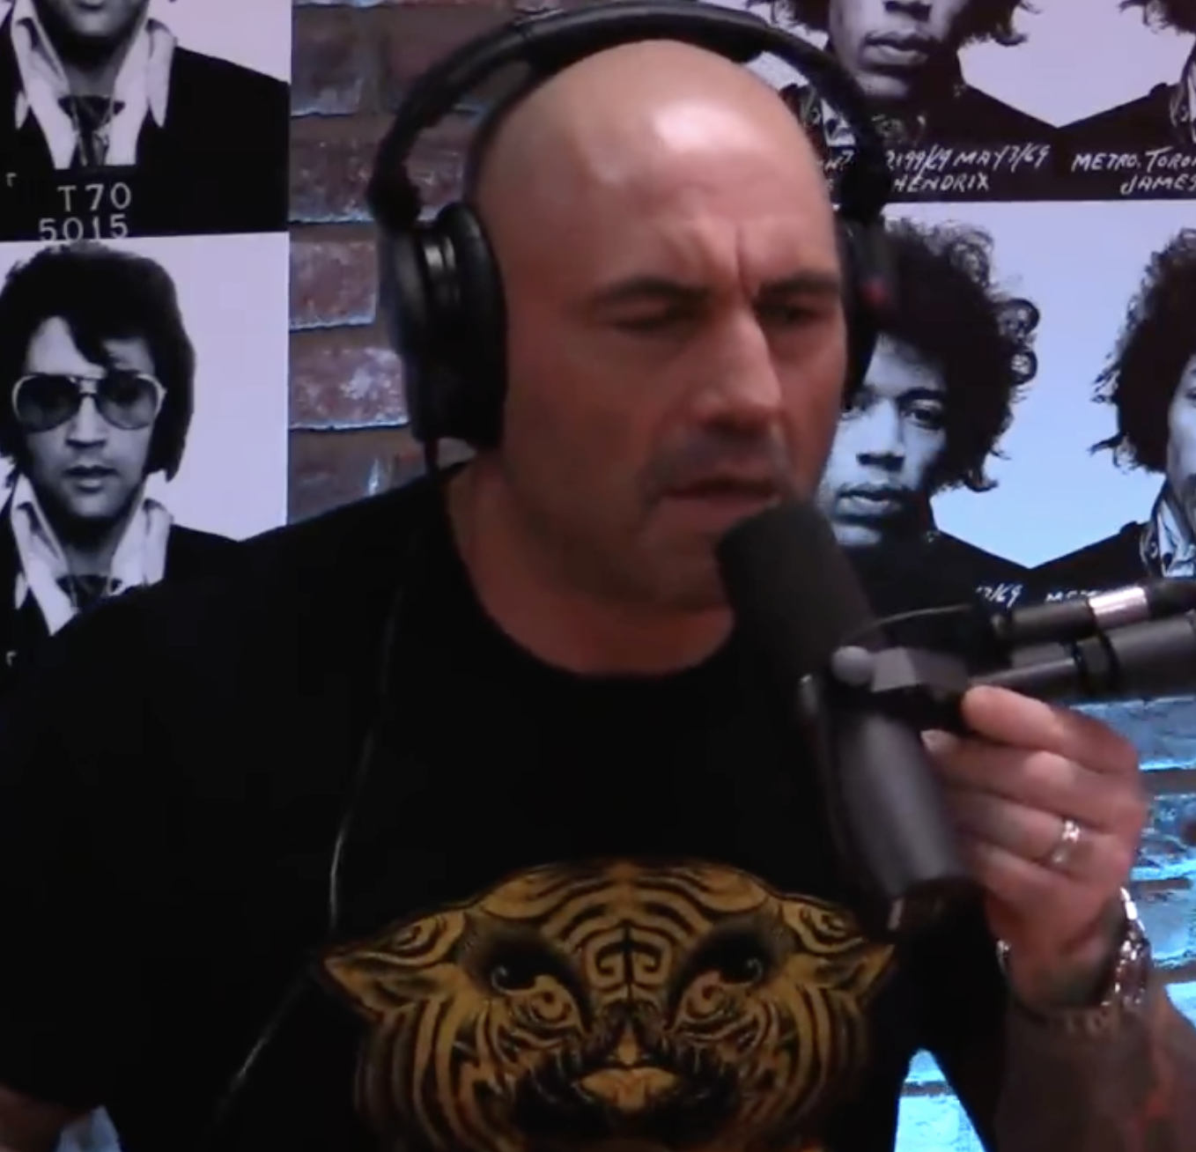
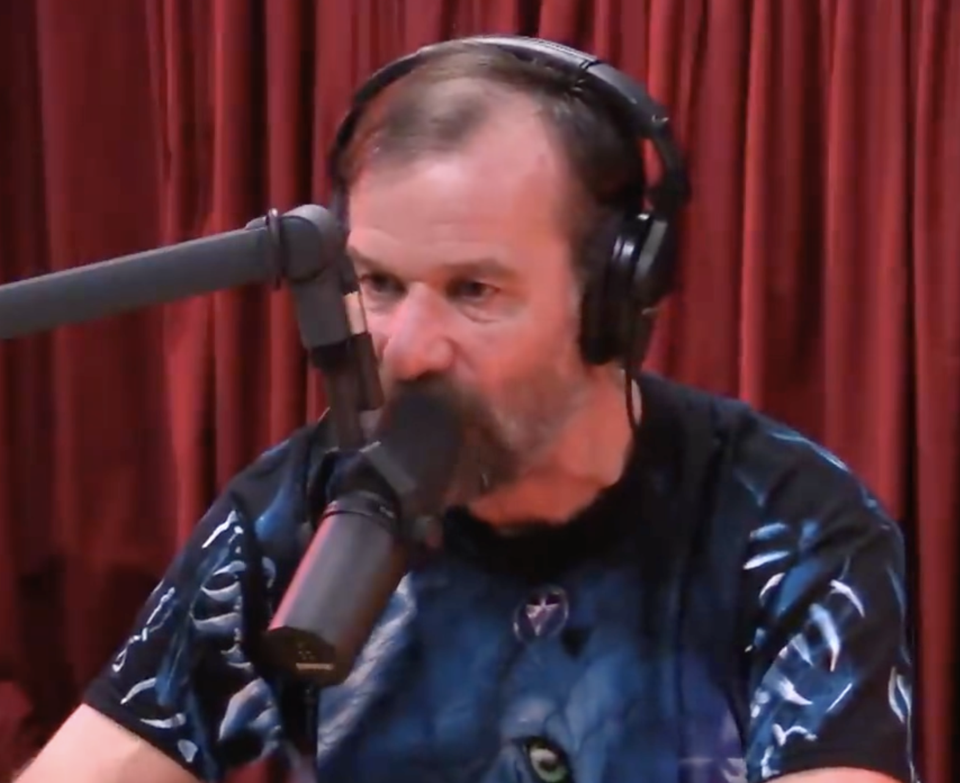
Credit: Spotify
Play from 1:26 to 3:39
Link to full episode:
https://open.spotify.com/episode/6TYjIjddUrlBLO4xgabW6u?si=HIUKDATeTRC0CJhfcqA8bA
How does the body respond to cold (and heat)?

Slide 6
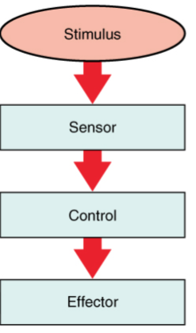
Draw a generic control system that maintains homeostasis in the body
(Receptor)
Center
Response
Credit: OpenStax

Slide 7
Glucocorticoids may be released when inflammation occurs, and they act to reduce the inflammation. The release of glucocorticoid hormones from the adrenal glands is stimulated by the release of hormones from the pituitary gland. This process is inhibited when glucocorticoid levels become elevated. Which part of a homeostatic control system is the stimulus in this process?
A – Release of glucocorticoid hormones from the adrenal glands
B – Inflammation
C – Release of hormones from the pituitary gland
D – Elevated glucocorticoid levels
Which event is the response?

Slide 8
What is the difference between positive feedback and negative feedback?
A – Positive feedback results in a positive effect on the body, negative feedback results in a negative effect
B – Positive feedback maintains the direction of a stimulus, negative feedback changes the direction of a stimulus
C – Positive feedback uses only effectors, negative feedback uses only receptors

Slide 9
Positive or negative feedback?
Click “A” for positive feedback and “B” for negative feedback. Enter all responses in a single answer (e.g. “ABAA”)
B
1. A person feels satiated after eating a large meal.
2. Oxytocin is a hormone released in response to cervical dilation. This causes more uterine contractions that will further dilate the cervix.
3. The blood has plenty of red blood cells. As a result, erythropoietin, a hormone that stimulates the production of new red blood cells, is no longer released from the kidney.
4. After cutting your leg from falling off your bike, platelets begin to clot your blood to stop the bleeding. Platelets release molecules that signal more platelets to join the injury site.
A
B
A

Slide 10
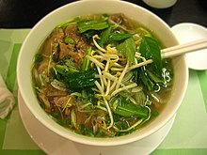
After eating a bowl of pho, your blood glucose level rises, which triggers insulin to be released from the pancreas. Insulin causes glucose to be transported into cells. If blood glucose is controlled by negative feedback, plot the blood glucose and insulin concentrations over time.
https://en.wikipedia.org/wiki/Pho#/media/File:Pho_in_Saigon.jpg
Blood glucose or insulin concentration
Time

Slide 11
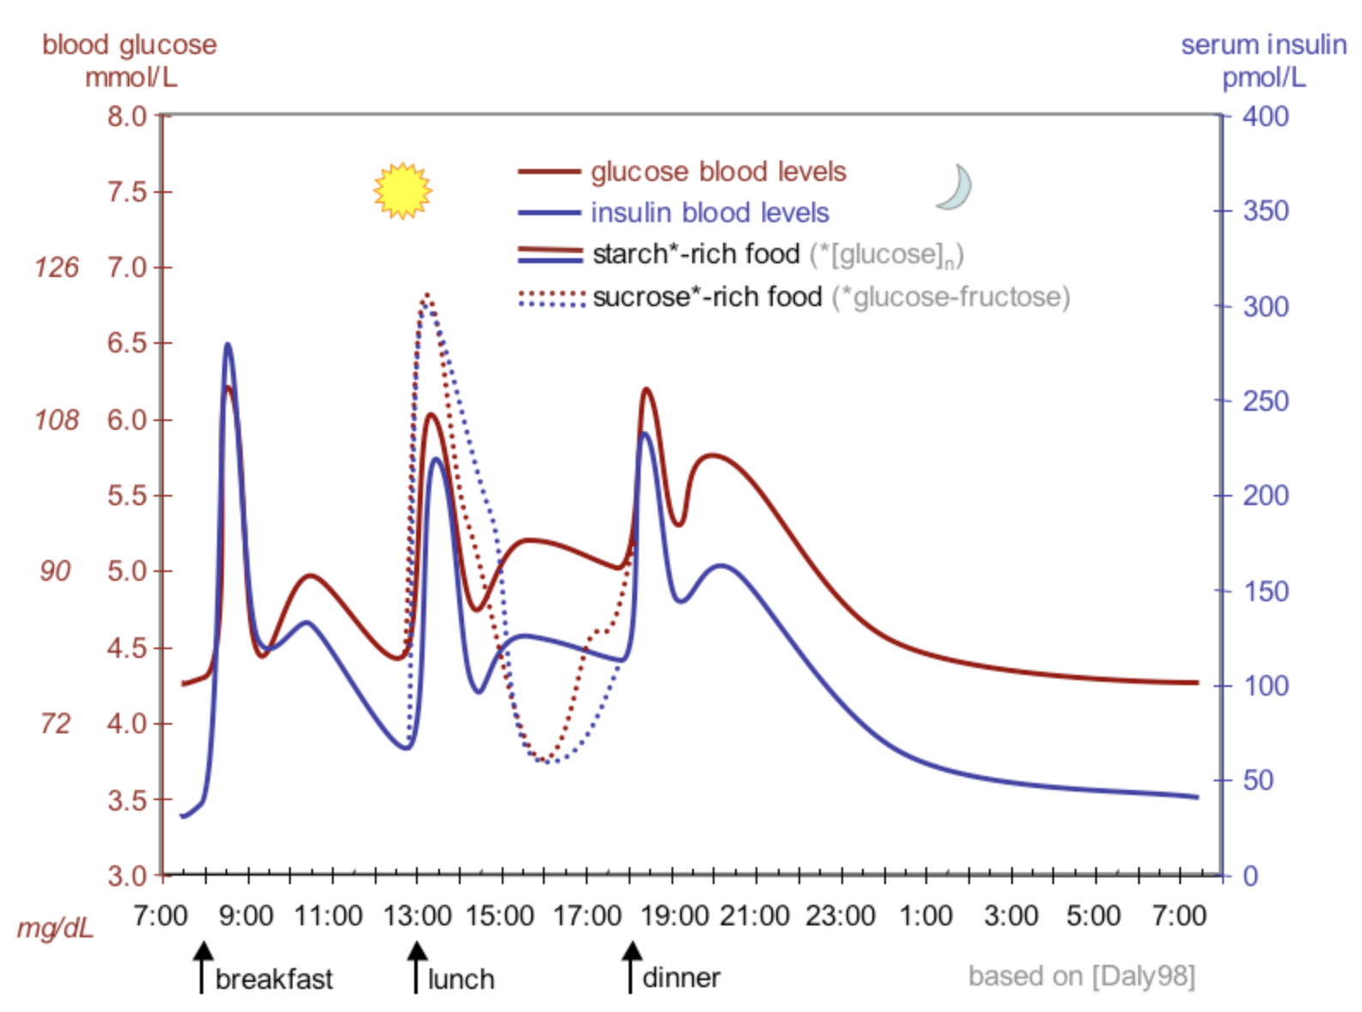
After eating a bowl of pho, your blood glucose level rises, which triggers insulin to be released from the pancreas. Insulin causes glucose to be transported into cells. If blood glucose is controlled by negative feedback, plot the blood glucose and insulin concentrations over time.
https://en.wikipedia.org/wiki/Pho#/media/File:Pho_in_Saigon.jpg
Which step in the process is the effector?
Blood glucose or insulin concentration
Time
https://upload.wikimedia.org/wikipedia/commons/4/4d/Suckale08_fig3_glucose_insulin_day.png

Slide 12
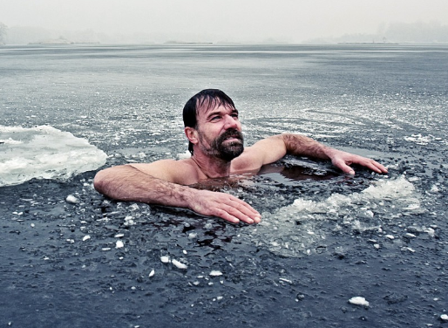
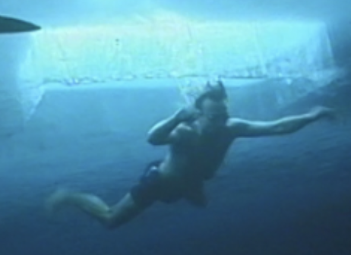
What would happen if you swam under ice?
On March 15, 2000, Wim Hof tried to break the world record for longest swim under ice with a single breath in Finland…
Draw a control system for how his body would respond to decreasing temperatures
https://nypost.com/2016/01/13/daredevil-fitness-trainer-runs-arctic-marathons-in-shorts/
https://newsinteractives.cbc.ca/longform/cold-water-adventurers/

Slide 13
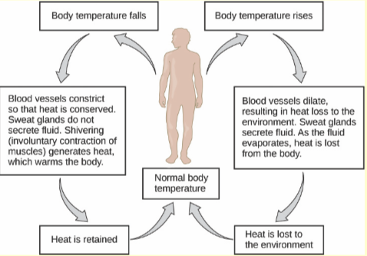
Credit: OpenStax

Slide 14
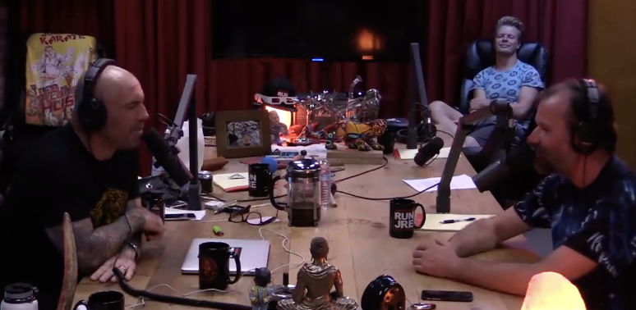
What happened when Wim Hof tried to swim under ice?
Credit: Spotify
Play from 59:56 to 1:03:17
Link to full episode:
https://open.spotify.com/episode/6TYjIjddUrlBLO4xgabW6u?si=HIUKDATeTRC0CJhfcqA8bA

