Slide 1
Muscle force calculations
https://en.wikipedia.org/wiki/David_Goggins
Designed by: Justin Shaffer
justin@recombinanteducation.com

Slide 2
Learning Objectives
Explain how muscles can be modeled as levers and calculate the amount of force a muscle can generate

Slide 3
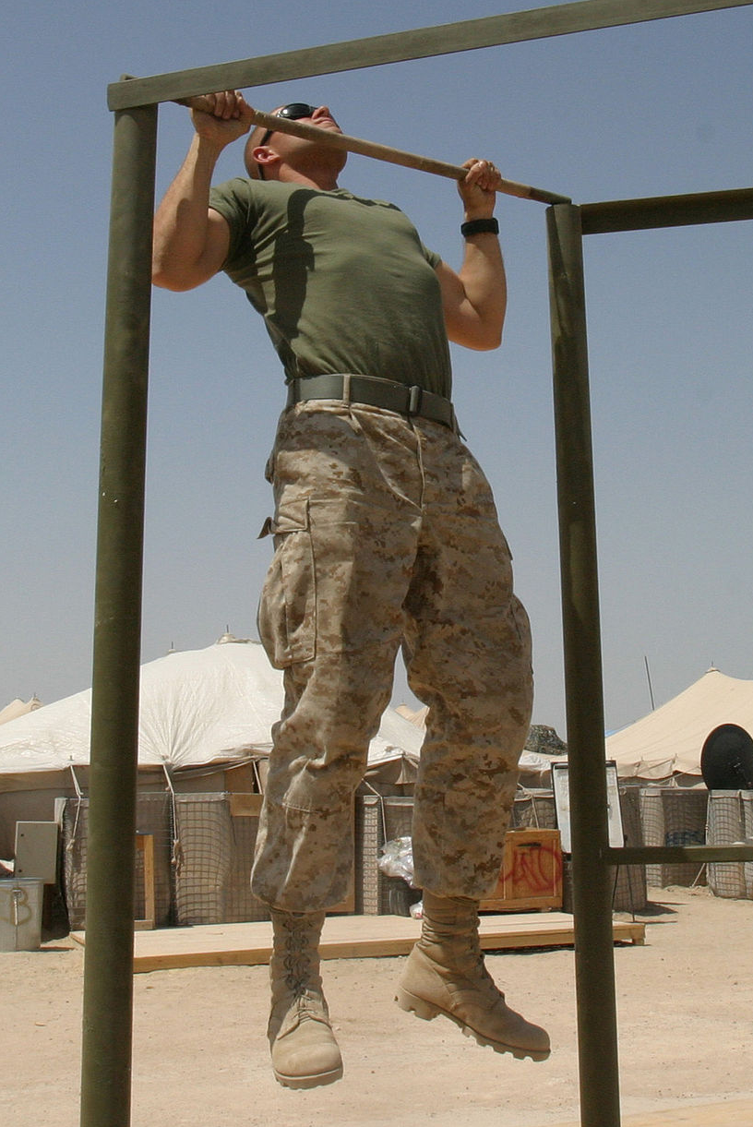
How much work does the upper body have to do for a 207 lb adult to do a pull-up?
A – 0.468 J
B – 4.68 J
C – 46.8 J
D – 468 J
E – 4680 J
https://en.wikipedia.org/wiki/Pull-up_(exercise)

Slide 4
PodCase: Muscle force calculations
Credit: Spotify

Slide 5
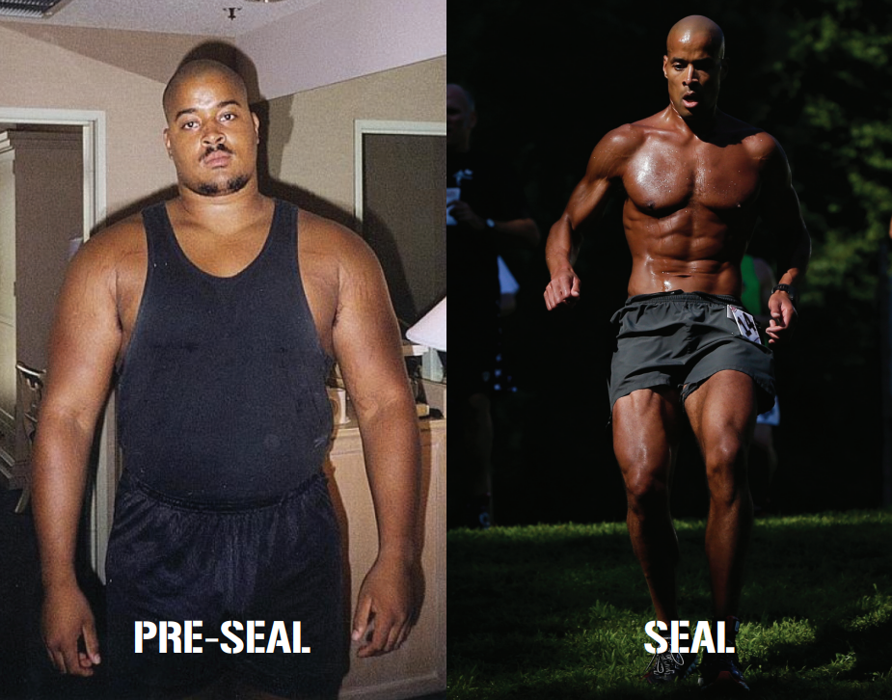
David Goggins
NAVY SEAL, Army Ranger, motivational speaker, author
Ultra-marathon runner and performance athlete
https://davidgoggins.com/about/
https://davidgoggins.com/
https://davidgoggins.com/book/
https://en.wikipedia.org/wiki/David_Goggins

Slide 6
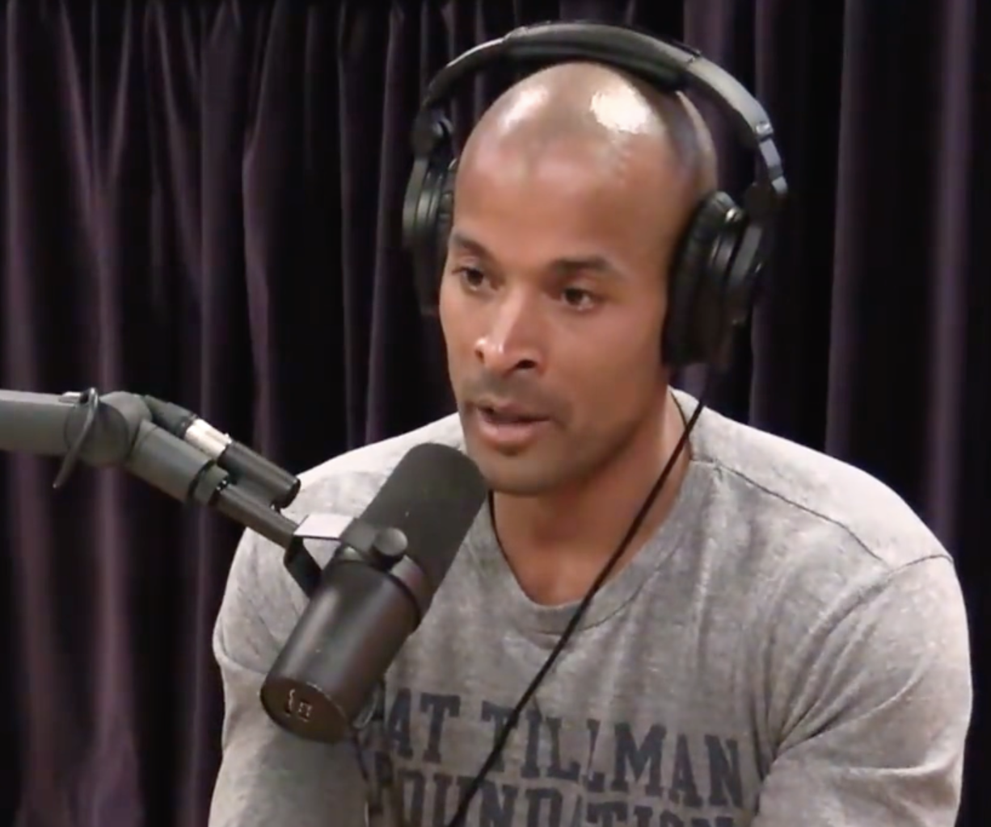
Credit: Spotify
Play from 0:00:37 to 0:02:10
Link to full episode:
https://open.spotify.com/episode/70ssh8DCCOlwwOEAjLobW3?si=yEP8wl8MRKW3BsxxMMxnrg
How much force do muscles produce?

Slide 7
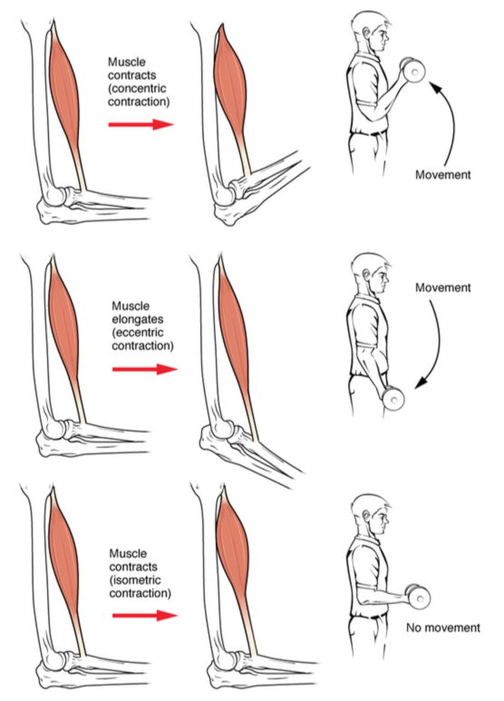
What are these types of contractions? Model them with your biceps brachii muscles!
Concentric
Eccentric
Isometric
Credit: OpenStax

Slide 8
What would you need to know to calculate how much force a muscle can produce?

Slide 9
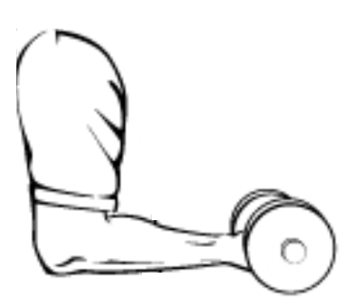
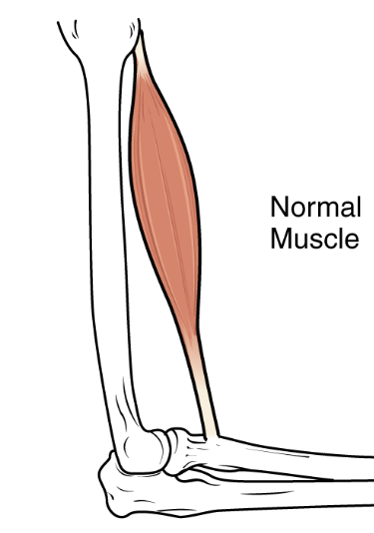
Biceps brachii
Force
Load
Fulcrum
Center of gravity
Lever
Modified from OpenStax

Slide 10
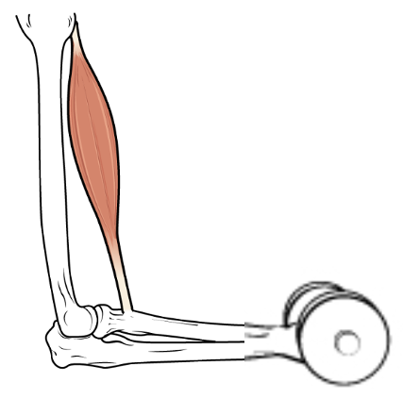
How much force (N) must biceps brachii exert to hold the forearm stationary at 90º if the forearm has a mass of 2 kg? How much additional force (N) must it exert if the hand is holding a 7 kg dumbbell stationary at 90º?
5 cm
10 cm
10 cm
Modified from OpenStax

Slide 11
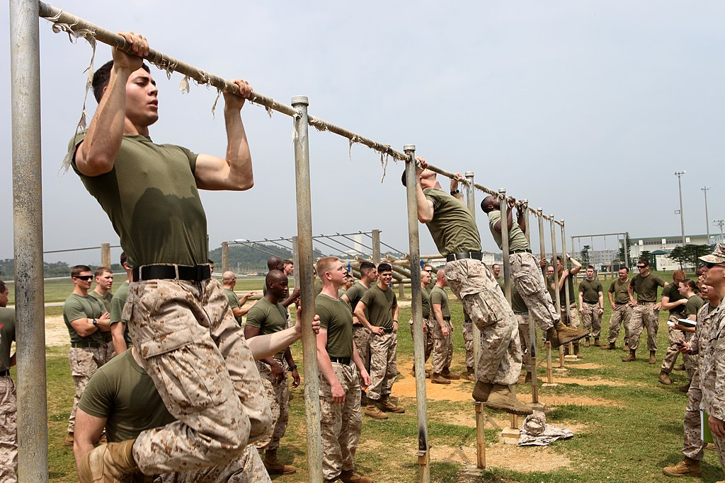
How much work does the upper body have to do for a 207 lb adult to do a pull-up?
https://en.wikipedia.org/wiki/Pull-up_(exercise)

Slide 12
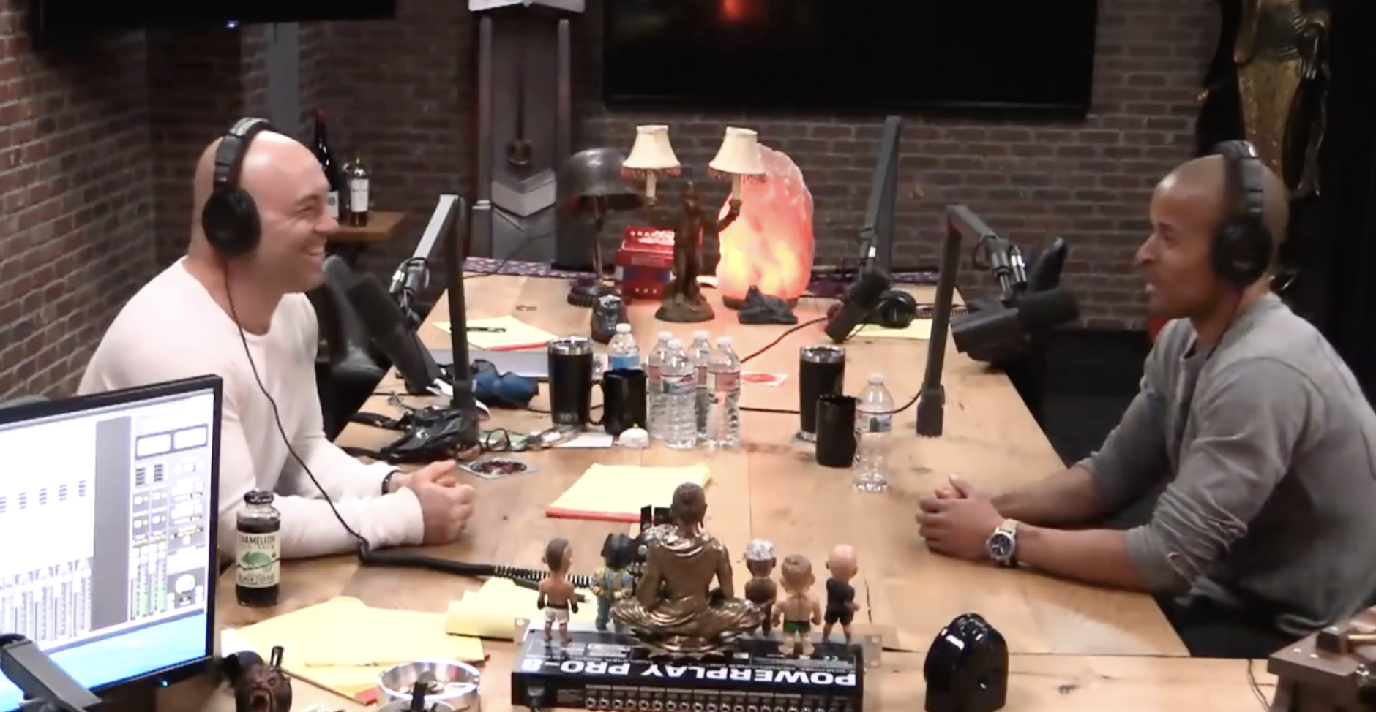
What happened when David Goggins tried to break the pull up record?
Credit: Spotify
Play from 1:16:32 to 1:18:25
Link to full episode:
https://open.spotify.com/episode/70ssh8DCCOlwwOEAjLobW3?si=yEP8wl8MRKW3BsxxMMxnrg

