Slide 1
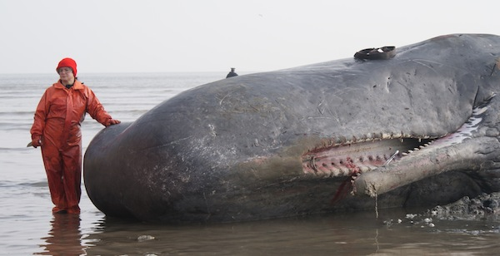
Cardiovascular anatomy
https://archive.org/details/inside-natures-giants-sperm-whale/Inside+Nature's+Giants+-+Sperm+Whale.m4v
Play from 0:54:25 to 0:55:58

Slide 2
Learning Objectives
Describe the location, external features, and functions of the heart
Identify and describe the structures and functions of the layers of the pericardium and heart wall
Identify and describe the structures and functions of the atria, ventricles, valves, and associated structures and trace the path of blood through the heart and great vessels

Slide 3
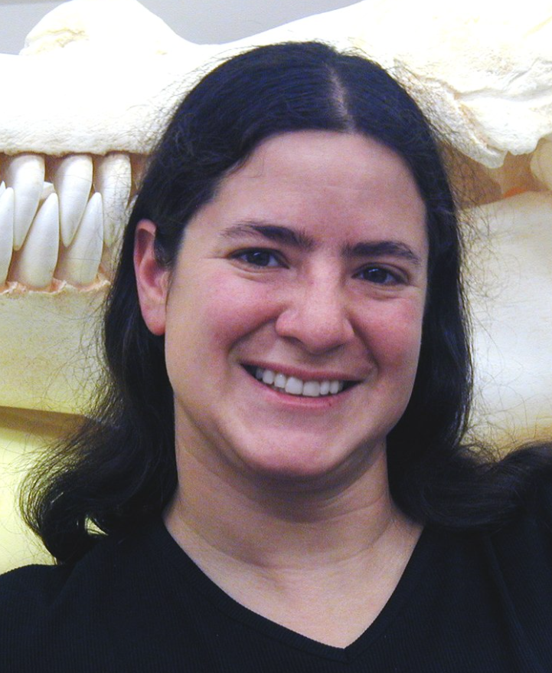
PodCase: Heart Anatomy
https://en.wikipedia.org/wiki/Alie_Ward
https://en.wikipedia.org/wiki/Joy_Reidenberg

Slide 4
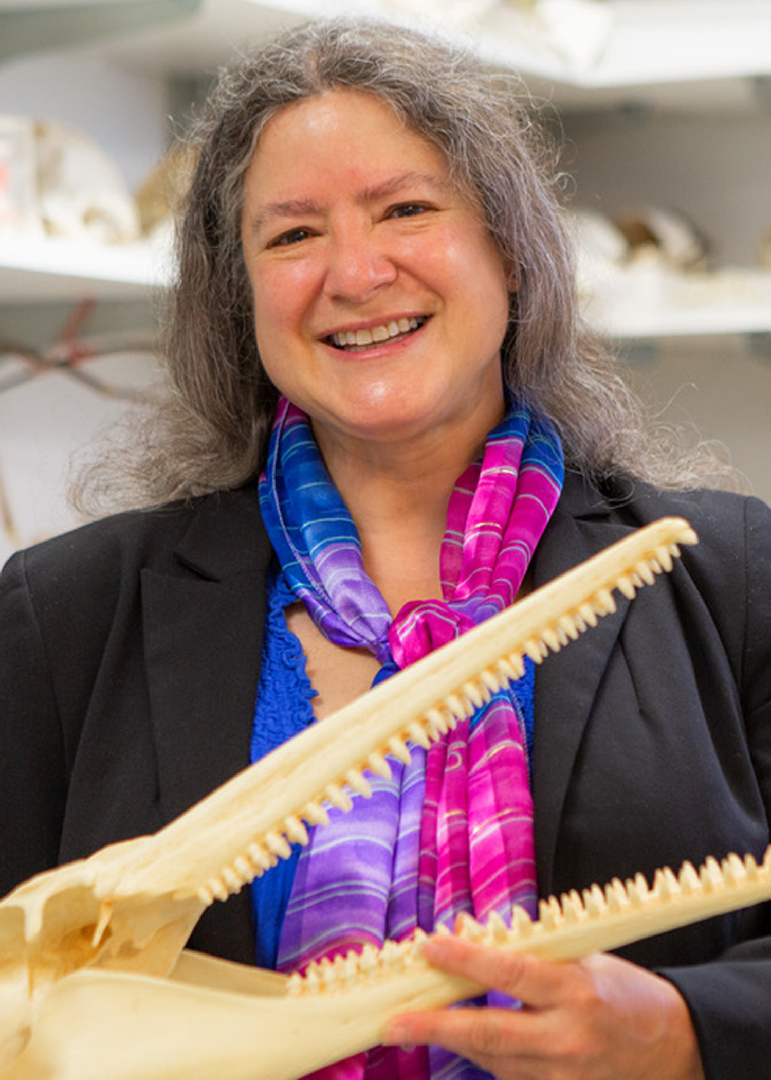
Joy Reidenberg
Professor, Center for Anatomy and Functional Morphology, and Dept. Medical Education, Icahn School of Medicine at Mount Sinai
Research focuses on anatomical adaptations of marine mammals to environmental extremes, specifically sound production
https://www.anatomy.org/AAA/About-AAA/Volunteering/2023-Board-Election/Board-Candidate-Reidenberg.aspx

Slide 5
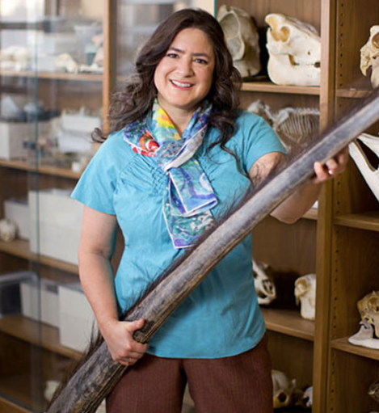
https://submergemag.com/lifestyle/alie-ward/
https://www.oprah.com/money/anatomist-joy-reidenberg-dissecting-animals
Play from 0:07:24 to 0:09:35
Link to full episode:
https://open.spotify.com/episode/2qM52HFYSKcP2E6LOng3q6?si=zsth1_MZTo240tbHeFd1Uw
What is it like to crawl inside a whale?

Slide 6
Where is the apex of the heart?
How many cavities is the heart housed in?
Ventral body cavity
Thoracic cavity
Mediastinum
Pericardial cavity

Slide 7
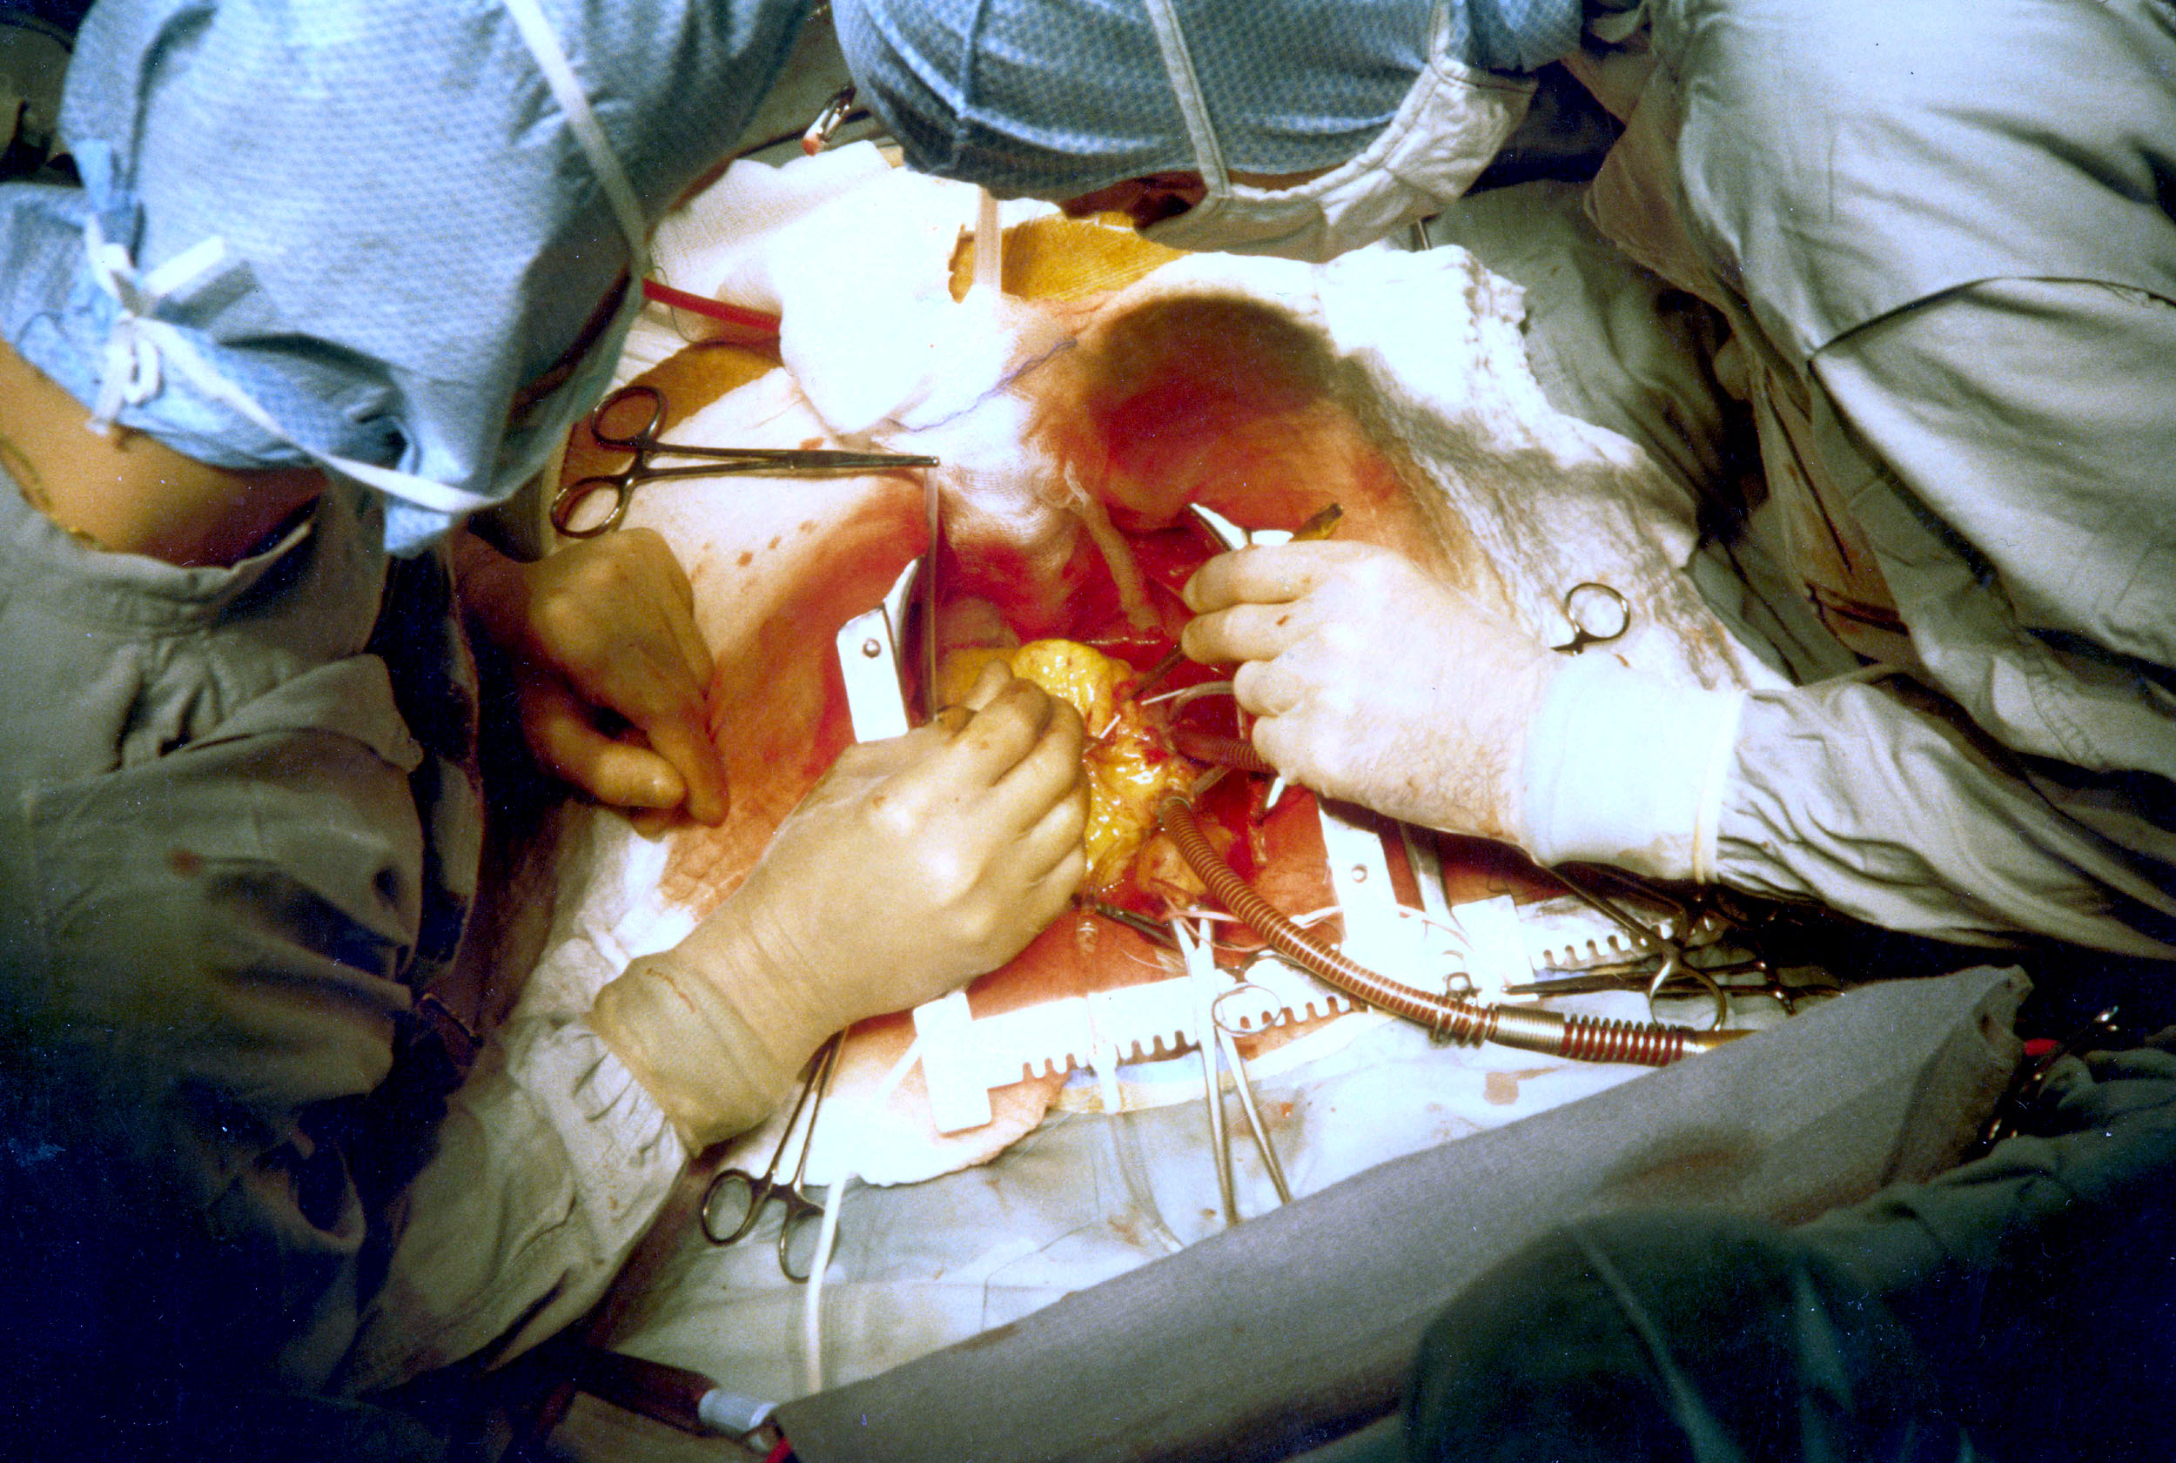
https://en.wikipedia.org/wiki/Cardiac_surgery
Open heart surgery
https://www.nhlbi.nih.gov/health/health-topics/topics/hs/types
https://medlineplus.gov/heartsurgery.html
https://www.youtube.com/watch?v=tRFMEeQCkpA

Slide 8
Fluid can build up in the pericardial cavity in severe cases of pericarditis, causing a condition called cardiac tamponade. To drain the fluid, a hypodermic needle is inserted into the pericardial cavity. What is the order of structures that the needle must pass through to drain the fluid?
A – Fibrous pericardium
B – Fibrous pericardium, epicardium
C – Fibrous pericardium, epicardium, myocardium
D – Fibrous pericardium, epicardium, myocardium, endocardium

Slide 9
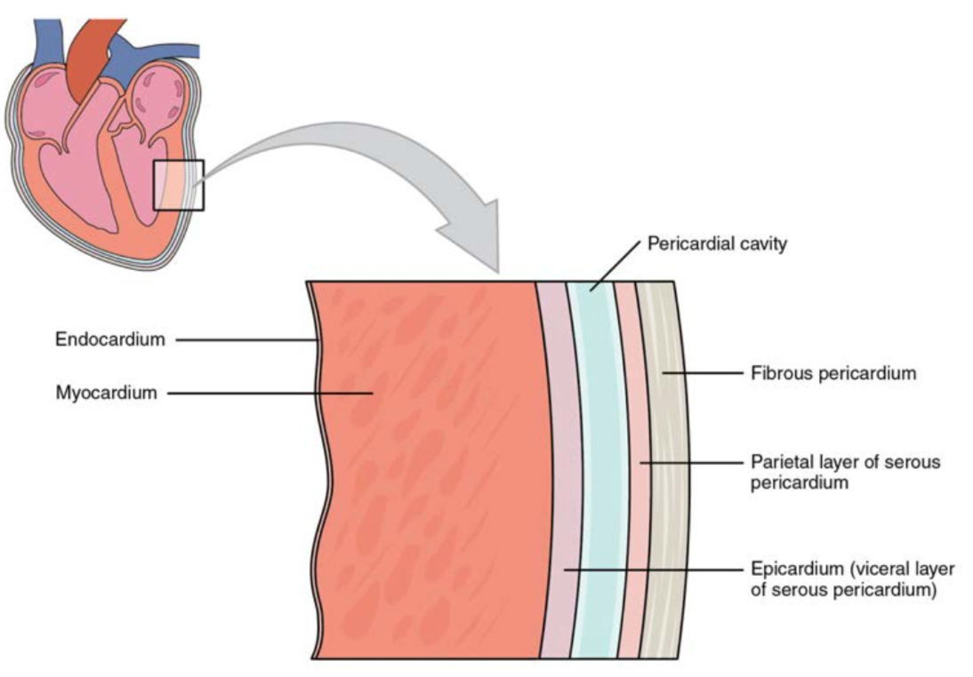
OpenStax

Slide 10
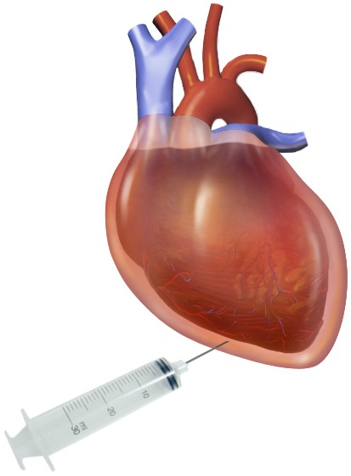
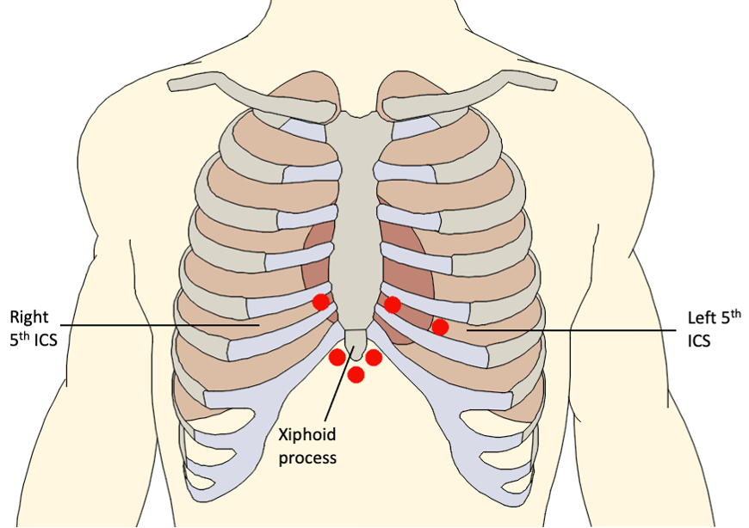
https://en.wikipedia.org/wiki/Pericardiocentesis
Pericardiocentesis
https://en.wikipedia.org/wiki/Pericardiocentesis
https://www.youtube.com/watch?v=gPvr2jxhpXA
https://www.nlm.nih.gov/medlineplus/ency/article/003872.htm
https://www.nlm.nih.gov/medlineplus/ency/article/000194.htm

Slide 11
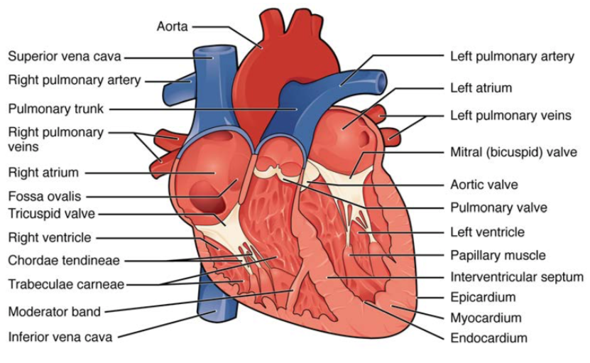
Name as many structures as you can in 30 seconds
GO!
OpenStax

Slide 12
OpenStax

Slide 13
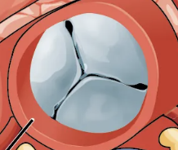
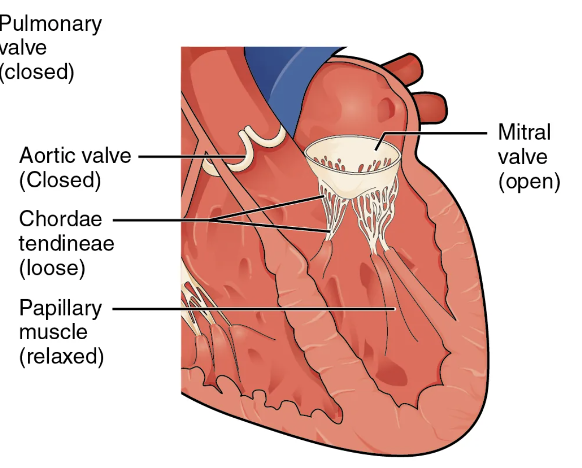
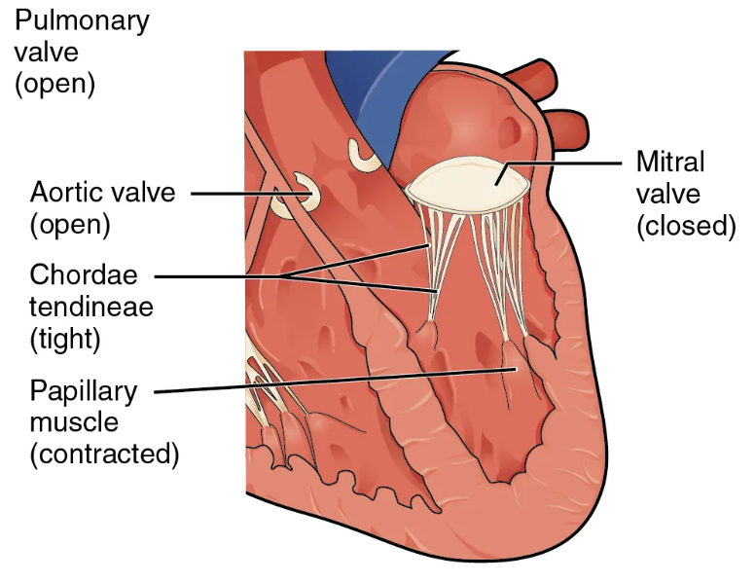
What valve could this be based on its shape? (superior view) Select all that apply.
A – mitral valve
B – tricuspid valve
C – pulmonary valve
D – aortic valve
OpenStax

Slide 14
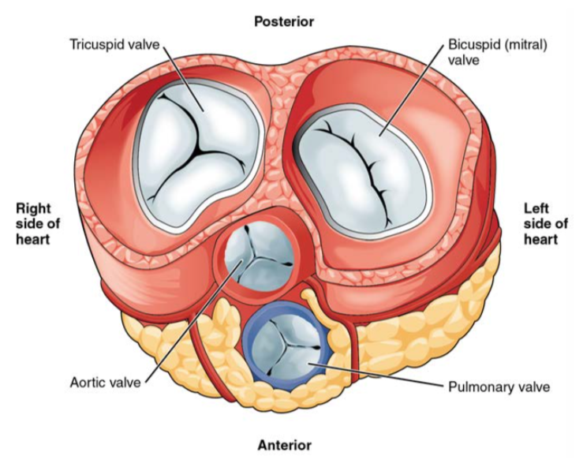
OpenStax

Slide 15
What are the functions of the chordae tendineae and papillary muscles?
A – to help open the AV valves
B – to help close the AV valves
C – to prevent the AV valves from closing
D – to prevent the AV valves from opening
OpenStax

Slide 16
How does blood travel through the heart and body?
Can you put the following structures in the correct order that a drop of blood would encounter them in the circulatory system?
Aorta
Right ventricle
Left ventricle
Mitral valve
Tricuspid valve
Pulmonary artery (trunk)
Superior vena cava
Aortic valve
Left atrium
Inferior vena cava
Left ventricle
Pulmonary vein
Pulmonary valve
Right atrium
Lungs (pulmonary capillaries)
Body (systemic capillaries)

Slide 17
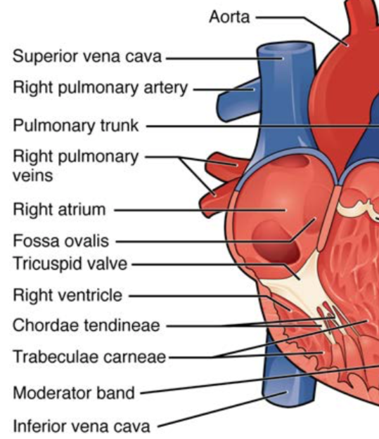
A drop of blood is in the right atrium. What structure was it just in and what valve will it pass through next?
A – right ventricle; tricuspid valve
B – superior vena cava; tricuspid valve
C – aorta; mitral valve
D – right ventricle; mitral valve
OpenStax

Slide 18
What is it like to crawl inside a whale?
https://submergemag.com/lifestyle/alie-ward/
https://www.oprah.com/money/anatomist-joy-reidenberg-dissecting-animals
Play from 0:51:40 to 0:53:41
Link to full episode:
https://open.spotify.com/episode/2qM52HFYSKcP2E6LOng3q6?si=zsth1_MZTo240tbHeFd1Uw

